Slide 1
Operator, Operand, and Arithmetic
Algorithm and programming

Slide 2
Learning Objectives
At the end of this session, student will be able to:
LO-1 : explain kind of algorithms in problem solving
LO-2 : apply syntax and functions in C language in problem solving

Slide 3
Subtopics
Operator and Operand
Assignment Operators
Arithmetic Operators
Relational Operators
Conditional Expressions
Logical Operators
Bitwise Operators
Pointer Operators
Precedence and Associative
Exercise

Slide 4
Operator and Operand
introduction
Operator is a symbol to process values in result for a new value
Operand is part which specifies what data is to be manipulated or operated on
Example :
C = A + B
Based on its operand number, operator can be divided into three:
  Unary operator (needs one operand)
  Binary operator (needs two operands)
  Ternary operator (needs three operands)
= and + sign are operators, A, B and C are operands

Slide 5
Operator and Operand
introduction
Based on its operation type, operator can be grouped as:
  Assignment Operator
  Logical Operator
  Arithmetic Operator
  Relational Operator
  Bitwise Operator
  Pointer Operator

Slide 6
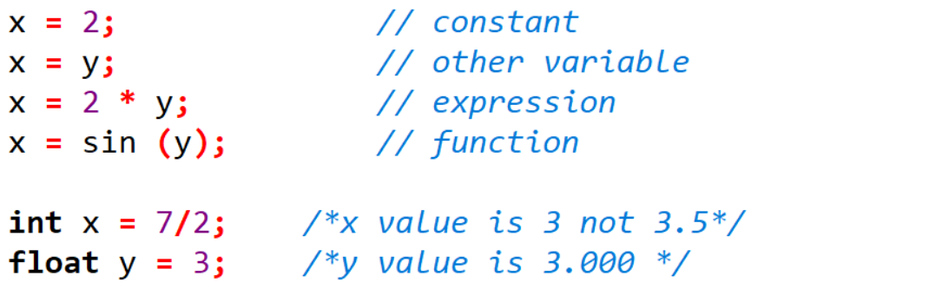
ASSIGNMENT OPERATOR
DEFINITION & EXAMPLE
A binary operator
Used in assigning value to an operand
Syntax:
  Operand1 = Operand2;
  Left hand side operand (Operand1) should have (L-Value) such as variable
  Right hand side operand (Operand2) can be constant, another variable, expression or function
Example:

Slide 7
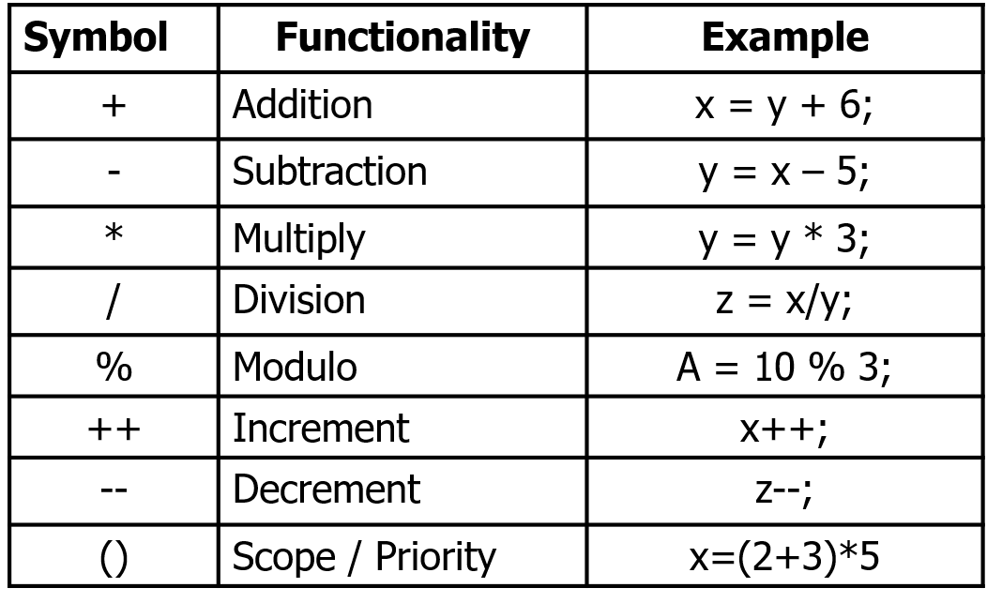
ARITHMETIC OPERATOR
DEFINITION

Slide 8
ARITHMETIC OPERATOR
DEFINITION & EXAMPLE
Modulo
Symbol : %
Binary operator
To find remainder of a division
N%2, can be used to find an odd or even number
  N%2 = 0 → N is even
  N%2 = 1 → N is odd
Increment and Decrement
Symbol : ++(increment), --(decrement)
Unary operator
Increase (++) and decrease (--) the value of a variable by 1.
Its position can be in the front (pre) or after (post) a variable.

Slide 9
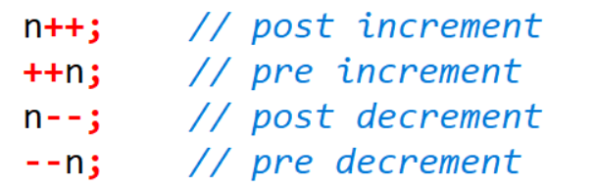
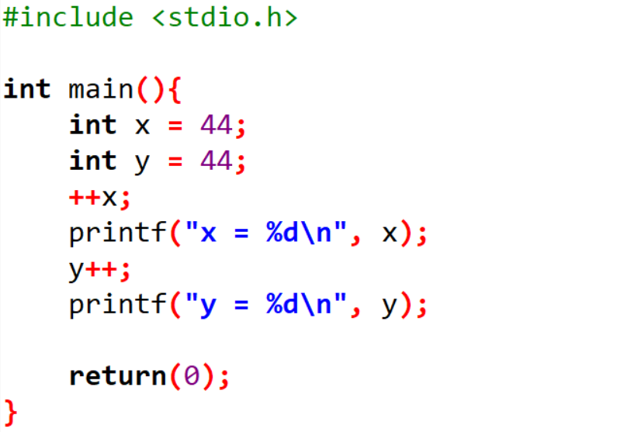
ARITHMETIC OPERATOR
INCREMENT & DECREMENT EXAMPLE
If a stand-alone statement:
  n++ or ++n equal to n=n+1;
  n-- or --n equal to n=n-1;
Output:
x = 45
y = 45

Slide 10
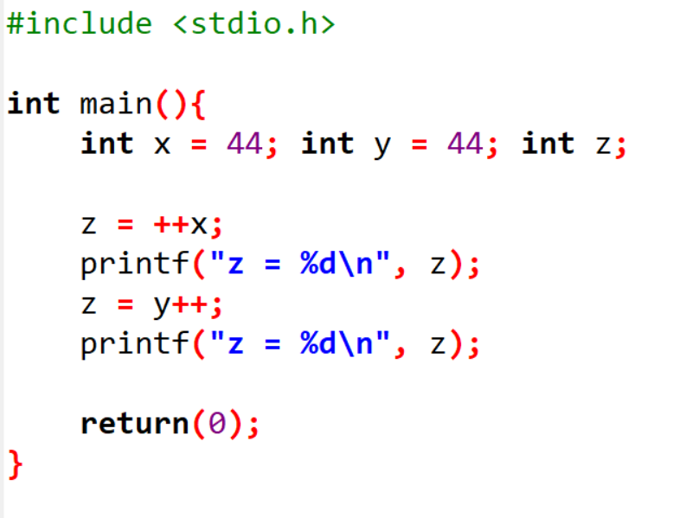
ARITHMETIC OPERATOR
INCREMENT & DECREMENT EXAMPLE
If ++n and n++ or --n and n-- as a bounded statement (sub expression), they have a different meaning:
  ++n
  n add by 1, then continue to process its expression
n++
process the expression initially, then add n by 1
Output:
z = 45
z = 44

Slide 11
ARITHMETIC OPERATOR
COMBINED OPERATOR
Every expression using the following form:
<Variable> = <Variable> <Operator> <Exp>;
has similar meaning with:
<Variable> <Operator> = <Exp>;
or also known as:
Combined Operator
Expression | Combined Operator
a = a + b; | a += b;
a = a – b; | a -= b;
a = a * b; | a *= b;
a = a / b; | a /= b;
a = a % b; | a %= b;
a = a ^ b ; | a ^= b;

Slide 12
ARITHMETIC OPERATOR
EXAMPLE
x *= y +1; has similar meaning with?
x = x * (y + 1);
x = x * y + 1;
x = x + 1 * y;
x = (x + 1) * y;

Slide 13
ARITHMETIC OPERATOR
EXAMPLE
x *= y +1; has similar meaning with?
x = x * (y + 1);
x = x * y + 1;
x = x + 1 * y;
x = (x + 1) * y;
Answer: a

Slide 14
Relational OPERATOR
DEFINITION
Used to compare values with TRUE or FALSE result
FALSE in C language equals to the value of 0
TRUE on the other hand not equal to 0
TRUE set by a C program at run time equal to the value of 1
Symbol | Functionality
== | Equality
!= | Not equal
< | Less than
> | Greater than
<= | Less or equal than
>= | Greater or equal than
?: | Conditional assignment

Slide 15
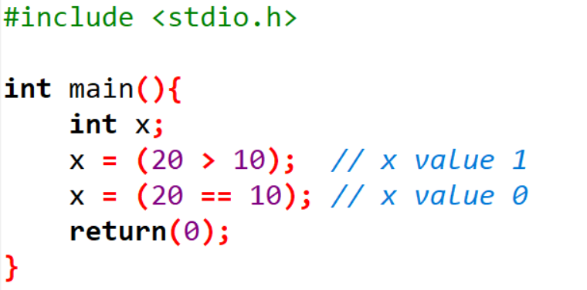
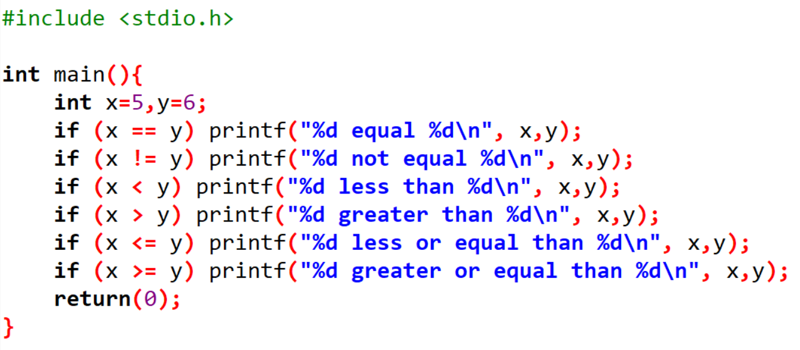
Relational OPERATOR
EXAMPLE
Output:
5 not equal 6
5 less than 6
5 less or equal than 6

Slide 16
Conditional Expressions
DEFINITION
Given the following statement:
  if(a > b) z = a;
  else z = b;
The above statement can be reformed to a conditional expression using ternary operator
Syntax :
  exp1 ? exp2 : exp3;
Example (similar meaning with the above statement):
  z = (a > b) ? a : b;

Slide 17
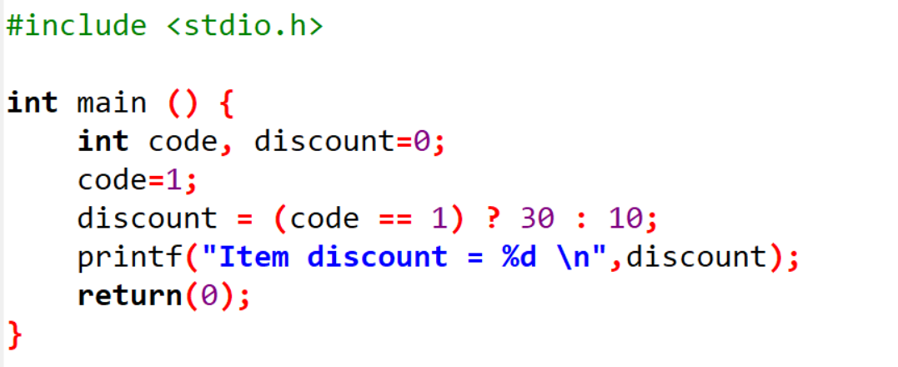
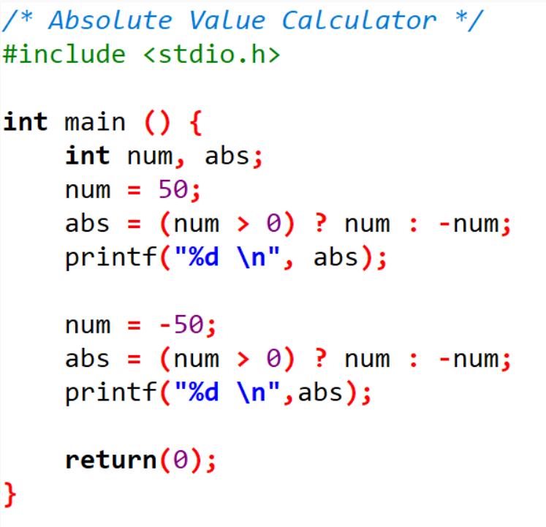
Conditional Expressions
EXAMPLE
Output:
Item discount = 30
Output:
50
50

Slide 18
Logical OPERATOR
DEFINITION
Logical operator symbols:
Logical operator truth table:
Symbol | Functionality
&& | AND
|| | OR
! | NOT
A | B | !A | A && B | A || B
True | True | False | True | True
True | False | False | False | True
False | True | True | False | True
False | False | True | False | False

Slide 19
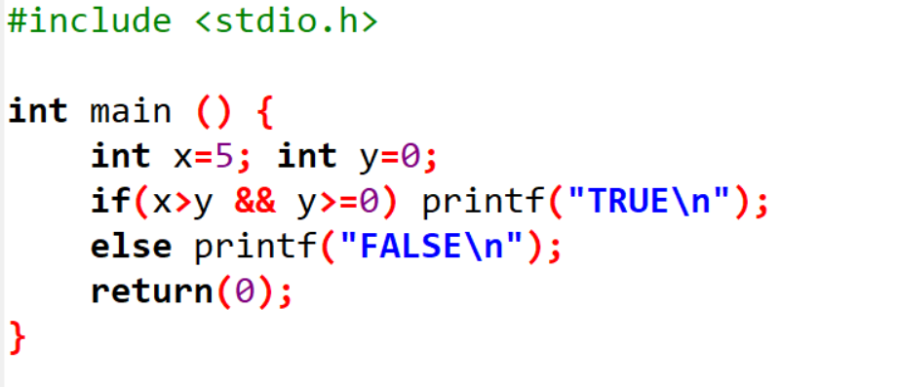
Logical OPERATOR
EXAMPLE
Operand in Logical Operator is the operand with TRUE or FALSE value
Example
Explanation:
5 > 0 → TRUE
0 >= 0 → TRUE
TRUE && TRUE → TRUE
Output:
TRUE

Slide 20
BITWISE OPERATOR
DEFINITION
Bitwise operator symbols are used for bit manipulation, which means they operate directly on the binary representations of integers.
Symbol | Meaning | Example
& | AND | A & B
| | OR | A | B;
^ | XOR | A ^ B;
~ | Complement | ~A;
>> | Shift Right | A >> 3;
<< | Shift Left | B << 2;

Slide 21
BITWISE OPERATOR
AND, OR
int A=24;
int B=35;
int C;
C = A & B; // value C = 0
C = A | B; // value C = 59
Explanation:
A = 24 binary: 011000
B = 35 binary: 100011
Bit by bit AND operation resulting : 000000, in decimal: 0
Bit by bit OR operation resulting : 111011, in decimal: 59

Slide 22
BITWISE OPERATOR
XOR
XOR operation of two bits resulting 1 if both bit are different and will result 0 if both are same.
int A = 45
int B = 75;
Int C = B^A; // Result C=102
Explanation:
A = 45 binary: 0101101
B = 75 binary: 1001011
Bit by bit XOR operation resulting : 1100110 or 102 in decimal

Slide 23
BITWISE Expressions
COMPLEMENT
To create a 1's complement (complement-1) of a value, every bit with a 0 is changed to 1, and every bit with a 1 is changed to 0.
int A, B = 0xC3;
A = ~B; // A now holds the 1's complement of B
Explanation:
0xC3 in binary: 1100 0011
1's complement: 0011 1100
In hexadecimal: 0x3C
*In C, writing a hexadecimal should start with 0x

Slide 24
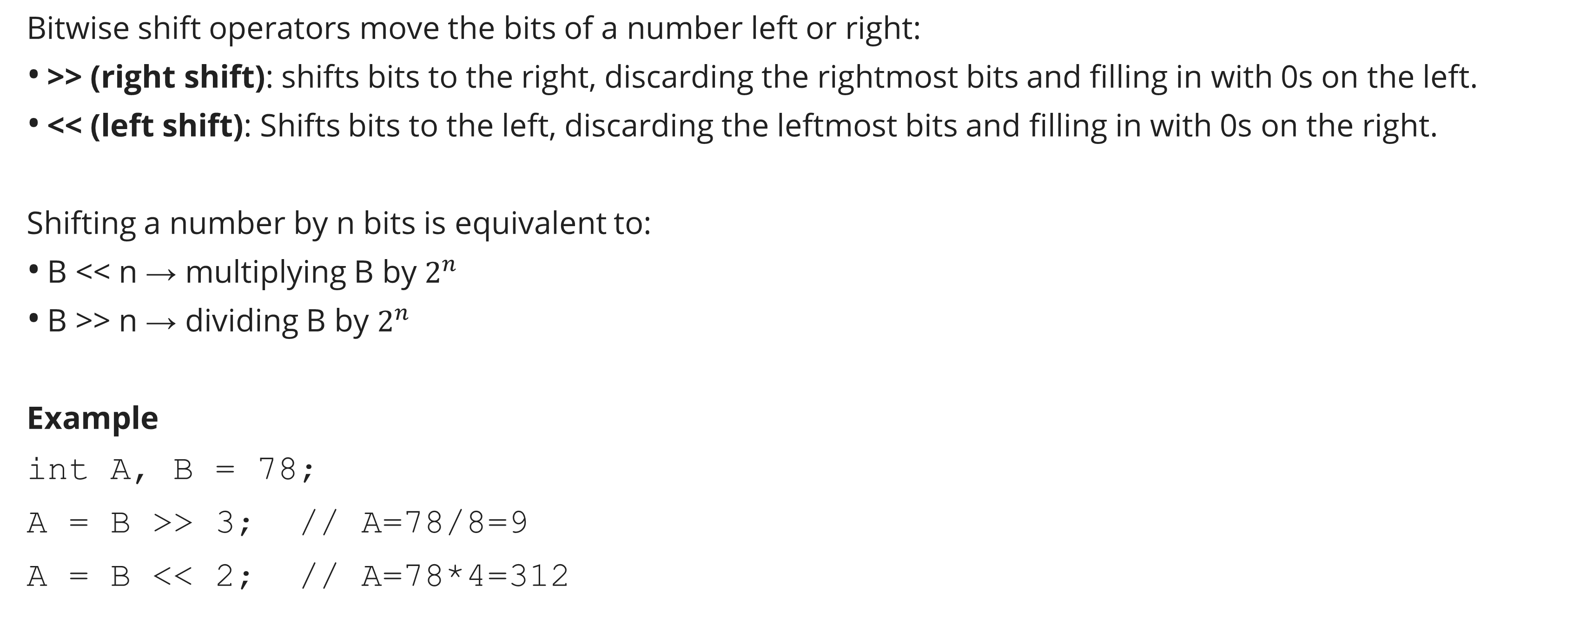
BITWISE Expressions
SHIFT
Bitwise shift operators move the bits of a number left or right:
>> (right shift): shifts bits to the right, discarding the rightmost bits and filling in with 0s on the left.
<< (left shift): Shifts bits to the left, discarding the leftmost bits and filling in with 0s on the right.
Shifting a number by n bits is equivalent to:
B << n → multiplying B by $2^{n}$
B >> n → dividing B by $2^{n}$
Example
int A, B = 78;
A = B >> 3; // A=78/8=9
A = B << 2; // A=78*4=312
Explanation:
B = 78 in binary: 0100 1110
B >> 3:
1st shift right: 0010 0111
2nd shift right: 0001 0011
3rd shift right : 00001001 → decimal 9
B << 2: Shift left by 2 bits → 1100 1000 → decimal 312

Slide 25
Pointer Operator
DEFINITION
Pointer operators consist of:
& (address operator):
Returns the memory address of a variable.
* (dereference operator)
Returns the value stored at the address the pointer is pointing to.Example:
Will be discussed on session 13-14

Slide 26
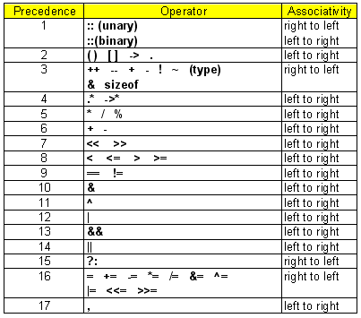
Precedence and ASSOCIATIVE
DEFINITION
Every operator will have precedence and associative.
Precedence determines the priority of operators in an expression.
  Operators with higher precedence are evaluated first.
Associativity determines the order of evaluation when two or more operators have the same precedence level.
  Associativity can be left to right (e.g., +, -, *, /) or right to left (e.g., assignment =, unary !, ~)

Slide 27
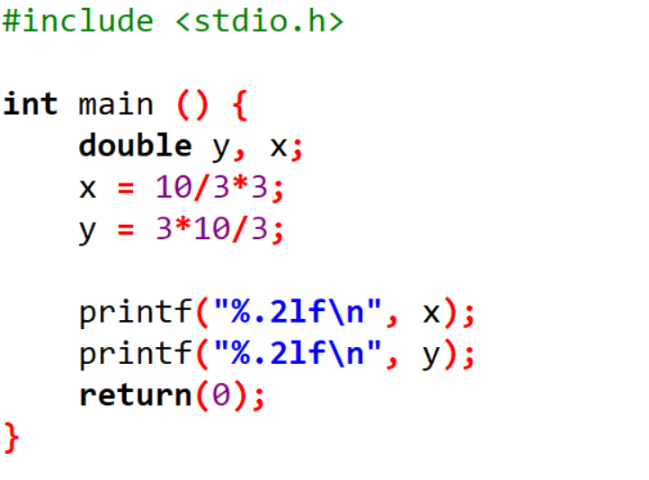
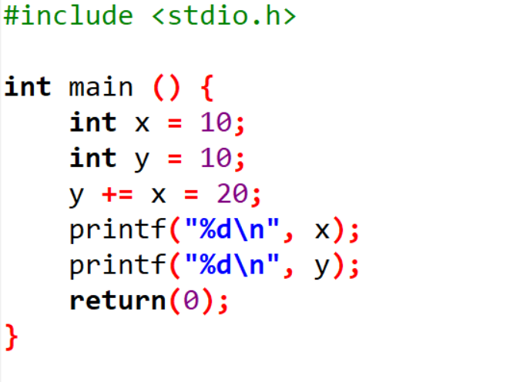
Precedence and ASSOCIATIVE
EXAMPLE
Output:
9.00
10.00
Output:
20
30

Slide 28
exercise
Question 1
If all variables are integer, then state the value of A if:
B=23; C=12; D=32; E=0;
A = B && E;
A = B & C;
A = C || D;
A = B | D;
A = B > 2;
A = B >> 2;
A = C < 3;
A = C << 3;
A = B = C;
A = B == C;

Slide 29
exercise
Question 2
#include <stdio.h>
int main()
{
int x=10, y=6;
x *= 5 + y;
printf("%d\n",x);
return(0);
}
What is value of x on the screen ?
Question 3
#include <stdio.h>
int main()
{
float x;
x=7/2;
printf("x = %f\n", x);
x=7.0/2;
printf("x = %f\n", x);
x=7.0/2.0;
printf("x = %f\n", x);
return(0);
}
What is value of x on the screen ?

Slide 30
exercise
Question 4
#include <stdio.h>
int main(){
int y=33, x=45;
y = y && x; printf("%d\n", y);
y = y & x; printf("%d\n", y);
y=33; x=45;
y = y & x; printf("%d\n", y);
y = y && x; printf("%d\n", y);
return(0);
}
What is value of y on the screen ?

Slide 31
exercise
Question 5
#include <stdio.h>
int main(){
int n = 10;
printf("%d\n", ++n);
printf("%d\n", n++);
n++;
printf("%d\n", n);
++n;
printf("%d\n", n);
return(0);
}
What is value of n on the screen ?

Slide 32
exercise
Question 6
z = (n > 0) ? f : b;
From the given conditional expression above, do f and b have a different data type?

Slide 33
Exercise
Create a program that:
1. Takes 2 inputs
2. Displays sum, product, quotient
3. Uses ternary to find max
Then:
- Ask ChatGPT to explain your logic
- Get 3 variations using different operators

Slide 34
Best Practices with AI Tools
Always understand the code AI gives
Experiment and learn, don’t just copy
Use AI explanations to verify logic
Combine traditional learning with AI guidance

Slide 35
AI Use and Reasoning
Sample Prompts to AI:
1. "What does x %= 3 mean in C?"
2. "Write a C program using arithmetic and ternary operators."
3. "Explain difference between logical && and bitwise &"
Reasoning:
Choose ternary instead of if-else after reviewing AI suggestions.
Clarify operator precedence via AI examples.

Slide 36
Evaluation
Are arithmetic and logical operators used correctly?
Is the expression logic correct?
Are code explanations or AI reflections provided?
Self-reflection:
Did the AI help simplify or improve your code?
What did you learn by comparing your logic with the AI?

Slide 37
SUMMARY
Operator is a symbol to process values in result for a new value
Operand is part which specifies what data is to be manipulated or operated on
Every operator will have precedence and associative

Slide 38
REFRENCES
Paul Deitel & Harvey Deitel. (2021). C how to program. 09. Pearson Education. New York. ISBN: 9780137398393.
Manipulating Data with Operators: http://aelinik.free.fr/c/ch06.htm
https://www.tutorialspoint.com/cprogramming/c_arrays.htm
https://replit.com/@templates/C-array
https://www.codeium.com

